Slide 1
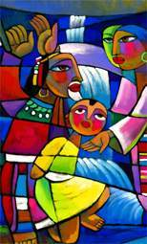

welcome
(Click to continue)

Slide 2
welcome
(Click to continue)

Slide 3
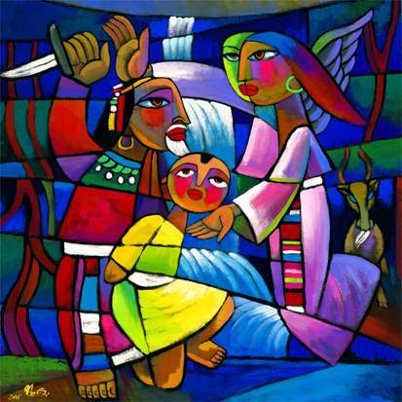
announcements
presented by:
Your
Name
(Click to continue)

Slide 4
finkmania
(Click to continue)

Slide 5
The “killing” commandment states:
“You shall not murder,”
“You shall not kill animals for food,”
“You shall not kill brain cells with hours upon hours of mindless video games,”
“You shall not kill, unless you can kill a lot of people all at once and call it ‘just war’”
finkmania
(Click to continue)

Slide 6
The “killing” commandment states:
“You shall not murder,”
“You shall not kill animals for food,”
“You shall not kill brain cells with hours upon hours of mindless video games,”
“You shall not kill, unless you can kill a lot of people all at once and call it ‘just war’”
finkmania
(Click to continue)

Slide 7
Which of the following is a type of murder?:
Physically harming someone,
Emotionally harming someone,
Spiritually harming someone,
All of the above
finkmania
(Click to continue)

Slide 8
Which of the following is a type of murder?:
Physically harming someone,
Emotionally harming someone,
Spiritually harming someone,
All of the above
finkmania
(Click to continue)

Slide 9
How might someone be “murdered” emotionally?:
By being neglected, criticized and ignored,
By being gossiped about,
By being dipped in honey and tied to a stake outside a colony of fire ants while being forced to listen to 37 of our pastor’s old sermons,
A and B and maybe C
finkmania
(Click to continue)

Slide 10
How might someone be “murdered” emotionally?:
By being neglected, criticized and ignored,
By being gossiped about,
By being dipped in honey and tied to a stake outside a colony of fire ants while being forced to listen to 37 of our pastor’s old sermons,
A and B and maybe C
finkmania
(Click to continue)

Slide 11
How might someone be “murdered” spiritually?:
By neglecting prayer,
By ignoring God’s Word,
By staying away from worship and fellowship with the Body of Christ,
All of the above and then some
finkmania
(Click to continue)

Slide 12
How might someone be “murdered” spiritually?:
By neglecting prayer,
By ignoring God’s Word,
By staying away from worship and fellowship with the Body of Christ,
All of the above and then some
finkmania
(Click to continue)

Slide 13
According to Jesus, who is our neighbor?:
Anyone who lives next door,
Anyone who lives in your town,
Anyone in trouble, even a feared or hated foreigner,
Only people with your color skin
finkmania
(Click to continue)

Slide 14
According to Jesus, who is our neighbor?:
Anyone who lives next door,
Anyone who lives in your town,
Anyone in trouble, even a feared or hated foreigner,
Only people with your color skin
finkmania
(Click to continue)

Slide 15
How does gossip break the “murder” commandment?:
It kills someone’s reputation,
It kills someone’s spirit,
Both A & B,
None of the above
finkmania
(Click to continue)

Slide 16
How does gossip break the “murder” commandment?:
It kills someone’s reputation,
It kills someone’s spirit,
Both A & B,
None of the above
finkmania
(Click to continue)

Slide 17
How does yelling at your parents or siblings break the “murder” commandment?:
It doesn’t—yell away!,
It might cause them to pop a few blood vessels, killing cells in their brain,
It hurts them, and one definition of killing includes hurting people in any way,
I haven’t the foggiest
finkmania
(Click to continue)

Slide 18
How does yelling at your parents or siblings break the “murder” commandment?:
It doesn’t—yell away!,
It might cause them to pop a few blood vessels, killing cells in their brain,
It hurts them, and one definition of killing includes hurting people in any way,
I haven’t the foggiest
finkmania
(Click to continue)

Slide 19
What are we supposed to do for our neighbor to truly keep the intent of this commandment?:
Leave them alone,
Ignore their problems,
Help them in their physical needs,
Call the police because their dog is always barking
finkmania
(Click to continue)

Slide 20
What are we supposed to do for our neighbor to truly keep the intent of this commandment?:
Leave them alone,
Ignore their problems,
Help them in their physical needs,
Buy them tickets to the “Barney on Ice” concert
finkmania
(Click to continue)

Slide 21
According to the intent of this commandment, killing is only ending a life:
True,
False,
Both A & B,
It depends on what your definition of “is” is
finkmania
(Click to continue)

Slide 22
According to the intent of this commandment, killing is only ending a life:
True,
False,
Both A & B,
It depends on what your definition of “is” is
finkmania
(Click to continue)

Slide 23
Exodus 20:13 tells us:
We are not to harm our neighbors in any way,
We are to help our neighbors in all of their physical needs,
Both A & B,
We are to only harm our neighbors when we feel threatened by them
finkmania
(Click to continue)

Slide 24
Exodus 20:13 tells us:
We are not to harm our neighbors in any way,
We are to help our neighbors in all of their physical needs,
Both A & B,
We are to only harm our neighbors when we feel threatened by them
finkmania
(Click to continue)

Slide 25
finkmania
(Click to continue)

Slide 26

tencommandments
(Click to continue)

Slide 27
“
„
You shall not murder.
Exodus 20:13
themeverse
(Click to continue)

Slide 28
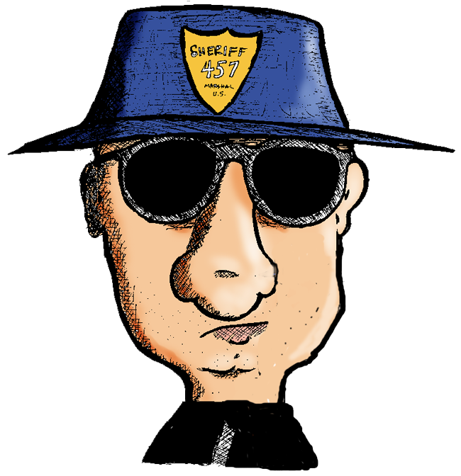
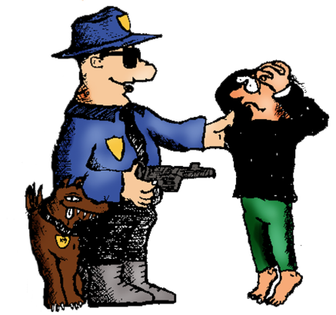

This is a decent, God-fearing country. We don’t allow any murders here.
And if you break this little rule…
We kill you.
finktoon
(Click to continue)

Slide 29
“
The Almighty God who created us commands that we do not kill, harm or injure others in any way.
This God desires that we help others in all of their physical needs.
„
remember1thing
(Click to continue)

Slide 30
Quiet your mind and body. Listen to your heartbeat. As you sense the beating, reach for another person’s hand and thank God for the gift of life.
openingprayer
(Click to continue)

Slide 31
L: Holy God, give us the power to reach for the best, the highest, the utmost in our relationships with each other and with Christ.
P: We will not harm our neighbor in any way.
openingprayer
(Click to continue)

Slide 32
L: Holy Jesus, release us from our locked, isolated ways. Forgive us for the times we hurt others this day and the times we refused to help.
P: We will not harm our neighbor in any way.
openingprayer
(Click to continue)

Slide 33
L: Holy Spirit, as sacred agents of your healing touch, help us to boldly risk reaching out with love and care to our hurting world.
P: We will not harm our neighbor in any way.
openingprayer
(Click to continue)

Slide 34
L: We pray in the name of the one who turned the other cheek, who traded love for violence, who gave his life to save ours, and forgave even those who drove the nails into his hands.
P: We pray in the name of Jesus. Amen.
openingprayer
(Click to continue)

Slide 35
(Click to continue)

Slide 36
lifeline
with special guest:
Guesty
Guesterton
(Click to continue)

Slide 37
The Fifth
Commandment

Slide 38
The Fifth Commandment:
You shall not murder.

Slide 39
What does this mean?
We should fear and love God so that we do not hurt or harm our neighbor in his body, but help and support him in every physical need.

Slide 40
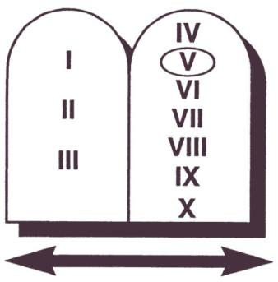
LIFE
God forbids…
God would have us…
taking of human life
  murder
  abortion
  euthanasia
  suicide
hurting or harming
our neighbor
keeping anger and hatred
in our hearts against others
help and support others
be merciful, kind, and
forgiving toward others
promote heath and wellness
The Fifth Commandment

Slide 41
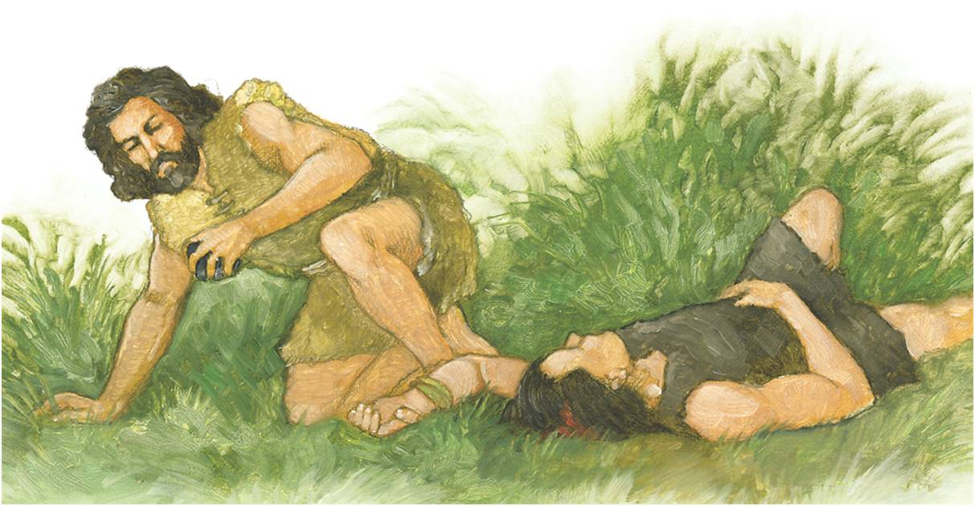
The Fifth Commandment
You shall not murder.

Slide 42
After Adam and Eve left the Garden of Eden, God gave them two sons, Cain and Abel. Cain grew up to become a farmer. Abel became a shepherd. Both Cain and Abel brought gifts to God. These gifts were burned on God’s altar. Abel gave God the best he had. Cain did not. God was pleased with Abel’s offering and not with Cain’s. Cain became jealous of Abel and killed him. God gave Adam and Eve another son named Seth (Genesis 4). From Seth’s family came the Savior, who died to take away all sins.
Compiled using Confirmation Builder © 2010 Concordia Publishing House.

Slide 43
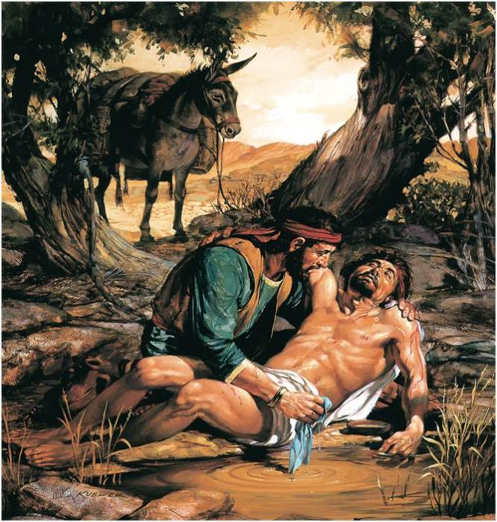
What does this mean? We should fear and love God so that we do not hurt or harm our neighbor in his body, but help and support him in every physical need.
Notes:
43

Slide 44
Jesus once told this story: “A certain man was walking from Jerusalem to Jericho. On the way, some thieves robbed and wounded him and left him half dead. Later, a Samaritan came and helped the man. (Samaritans and Jews were enemies.) The Samaritan bandaged the man’s wounds and took him to a place where he could receive care” (Luke 10:30–37). The Samaritan reminds us of Jesus. He came to help and save all people, including enemies and those who don’t know Him.
Compiled using Confirmation Builder © 2010 Concordia Publishing House.

Slide 45

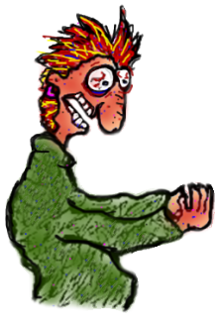
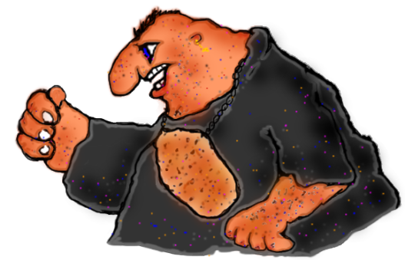
Cookie Crumbles
skit
written by:
Rich
Melheim
(Click to continue)

Slide 46

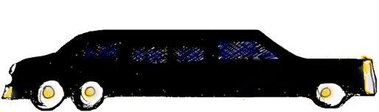
Road
Rage
skit
written by:
PJ
McCluskey
(Click to continue)

Slide 47
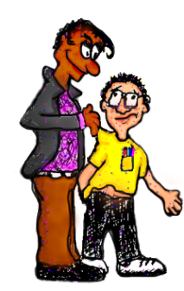
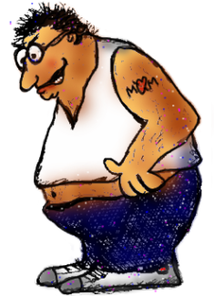
Bullying Session
skit
written by:
Pete
Erickson
(Click to continue)

Slide 48
images&analogies
(Click to continue)

Slide 49
artattack
(Click to continue)

Slide 50

School Shootings
Virginia Tech
Blacksburg, VA
Columbine High Littleton, CO
Westside Middle School Jonesboro, AK
Heritage High Conyers, GA
Red Lake High School Red Lake, MN
images&analogies
(Click to continue)

Slide 51
Media Mix
Listen to “Goodbye Earl” by the Dixie Chicks
Is it ever okay to kill?
Did these women act properly?
images&analogies
(Click to continue)

Slide 52
Media Mix
Watch the suggested scene from Austin Powers in Goldmember
Have you ever been in a situation where you said the wrong thing, even though you knew better?
Why is self-control such a wonderful thing to have?
Who followed the “killing” commandment better in this scene: Austin Powers or Number 3 (the mole)?
images&analogies
(Click to continue)

Slide 53
What Is Murder?
Physical
Emotional
Spiritual
images&analogies
(Click to continue)

Slide 54
Trash Talk
Common Verbal Murder
Insults
Sarcasm
Verbal Harassment
Think of a time when you were hurt by words recently. Share one on one with another person
Make an “anti-trash talk” covenant together and pledge to keep it this week
images&analogies
(Click to continue)

Slide 55
9/11
How have we responded as a nation and individuals?
What was Jesus’ reaction to personal violence?
How do Christ’s words and actions contrast with the messages we hear around us?
images&analogies
(Click to continue)

Slide 56
weakestfink
(Click to continue)

Slide 57
Capital Punishment
Killing someone who has killed
Inflicting the death penalty for a crime
This is usually done with government approval
From the Latin caput = head + poena = punishment
weakestfink
(answer)
(Click to continue)

Slide 58
Kill
Harming our neighbor in any way
There are physical, emotional and spiritual aspects to killing
It may be done with words and actions (commission)
It may be done when we refuse to stand up for our neighbors or come to their aid (omission)
weakestfink
(answer)
(Click to continue)

Slide 59
Murder
The unlawful killing of human being by another
Often done with premeditated malice
To destroy or put an end to
From the Old English mordor
weakestfink
(answer)
(Click to continue)

Slide 60
Neighbor
Everyone in the world
According to Jesus, even our enemies are in this position
Jesus answered the question, “Who is my _______?” in the parable of the Good Samaritan
From the Old English neah = near + gebur = dweller
weakestfink
(answer)
(Click to continue)

Slide 61
War
A state of open, armed, often prolonged conflict between nations
A condition of active antagonism or hostility
A battle of physical, emotional or spiritual wills
What is it good for? Absolutely nothing.
weakestfink
(answer)
(Click to continue)

Slide 62
weakestfink
(Click to continue)

Slide 63
bibletime
Open your
Bibles!
And grab your highlighters, too!
(Click to continue)

Slide 64
“
„
You shall not murder.
Exodus 20:13
themeverse
(Click to continue)

Slide 65
Other Key Verses
Divide into groups to read and highlight the following
What does each verse have to do with the theme verse?
Genesis 4:9
Psalm 59:7
Matthew 26:52
Hebrews 10:30
bibletime
(Click to continue)

Slide 66
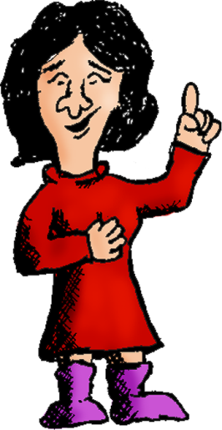
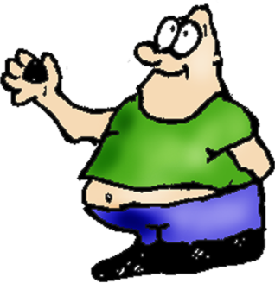
I am proud to say I’ve
never broken the “kill”
commandment!
Hey Sis! May I offer you…
finktoon

Slide 67
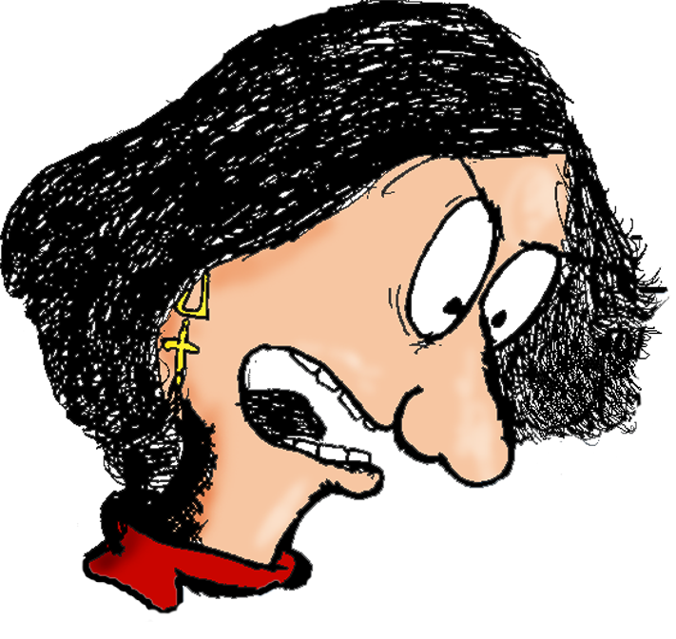
Shut your
face you little
maggot and
get out of …
finktoon
my
Room!

Slide 68

finktoon

Slide 69
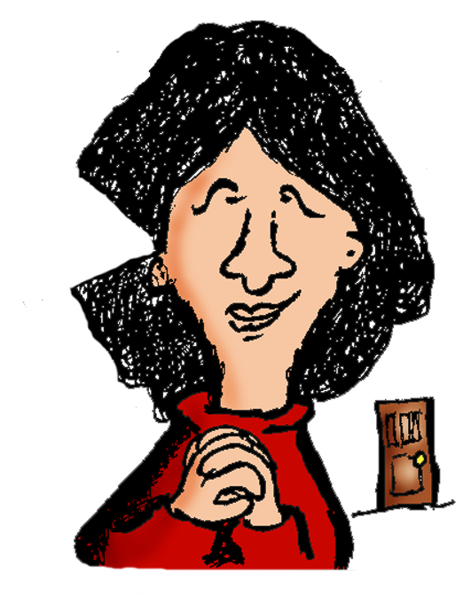

…offer you a
piece of
(sniff) candy…
Like I said,
I never killed anyone!
finktoon
(Click to continue)

Slide 70


smallgrouptime
(Click to continue)

Slide 71





SHARE
Highs & Lows
READ
and highlight the
theme verse in Bibles
TALK
smallgrouptime
about Highs & Lows,
relate them to the verse
PRAY
for one another
BLESS
one another
(Click to continue)

Slide 72
(Click to continue)

Slide 73
wrapup
(Click to continue)

Slide 74
Share one thing new your group heard today
Share one thing your group already knew that is worth repeating
Share one thing your group would like to know more about
groupreflections
(Click to continue)

Slide 75
“
„
You shall not murder.
Exodus 20:13
themeverse
(Click to continue)

Slide 76
“
The Almighty God who created us commands that we do not kill, harm or injure others in any way.
This God desires that we help others in all of their physical needs.
„
remember1thing
(Click to continue)

Slide 77
“
God commands us not to kill. Whenever we harm people in any way - physically, emotionally or spiritually - we are killing a precious piece of them.
„
wrapup
(Click to continue)

Slide 78
“
„
God says “Don’t do it!” In a world that tears down, we are to build one
another up.
wrapup
(Click to continue)

Slide 79
“
This is not a suggestion.
It is God’s fifth commandment.
„
wrapup
(Click to continue)

Slide 80
prayerjourney
(Click to continue)

Slide 81
ptaprayer
(Click to continue)

Slide 82
“
(Name), child of God, may you be an agent of God’s healing this day.
Response: In Jesus’ name. Amen.
„
blessing
(Click to continue)

Slide 83
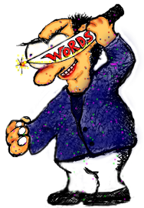
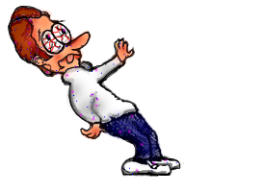

Copyright ©
by Faith Inkubators. Permission to use this presentation is granted to current Members of Faith Inkubators.
Unauthorized use is a breach of copyright.
Please don’t rip us off.
It would kill our future.
Really.
www.faithink.com

